Slide 1
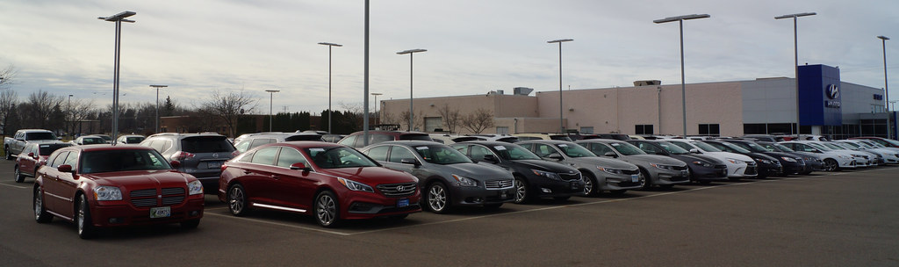
Used Car Price Prediction
By
Dhrubajyoti Mandal

Slide 2
Content
Problem Statement
Data Summary
Data Preprocessing
Exploratory Data Analysis
Feature Engineering
Data Visualization
Model Building with Regression techniques
Hyper parameter tuning the Best Model
Conclusion

Slide 3

Problem Statement
With the covid 19 impact in the market, we have seen lot of changes in the car market. Now some cars are in demand hence making them costly and some are not in demand hence cheaper.
One of our clients works with small traders, who sell used cars.
With the change in market due to covid 19 impact, our client is facing problems with their previous car price valuation machine learning models.
So, they are looking for new machine learning models from new data. We have to make car price valuation model.

Slide 4
Data Summary
Brand: Brand of the car.
Model: Model name of the car
variant: Variant specifies the type of the engine, model type(base model ,top model etc..).
Transmission: It specifies if it is an automatic or manually driven gear car.
Year of Manufacturing: It gives the year manufacturing year of the car i.e. with which we can find how old the car is.
Driven_in_km: Identifies the total distance driven by the car in km.
Fuel_type: By this feature we can know the type of fuel used for the car(petrol/diesel/CNG)
No of Owners: it says how many times the car is being resale i.e. change in number of owners.
Location: Specifies the location.
Price: The price of the car
Observation:
1. 10 Independent variables with Price as target variables.
2. From the dataset we can infer that it is clearly a regression problem.
3. The dataset consists of 11 rows and 4533 columns

Slide 5

Exploratory Data Analysis ( EDA)

Slide 6
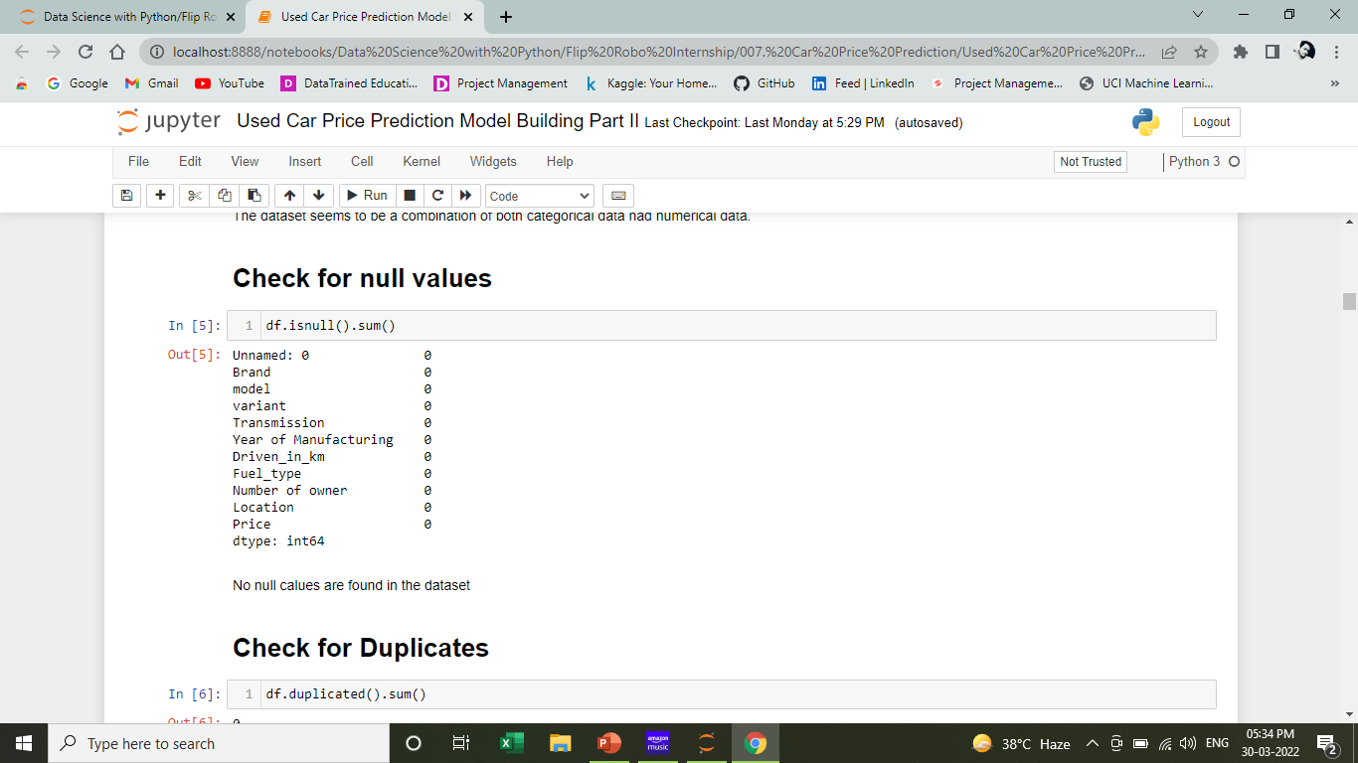
Visualize for Null Values
OBSERVATION:
The data is very clear with no null values seen in it.

Slide 7
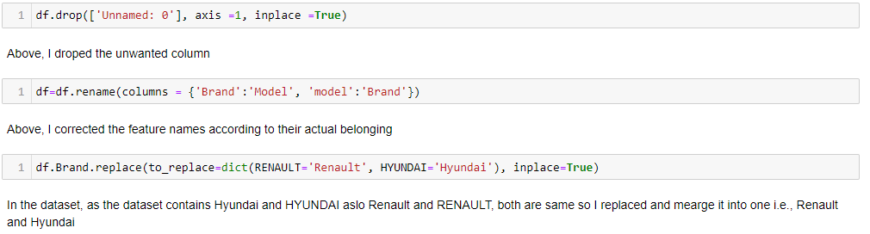
Data Preprocessing
Observations:
Remove unwanted feature
Renamed the Brand and Model
Merge some of the classes.

Slide 8
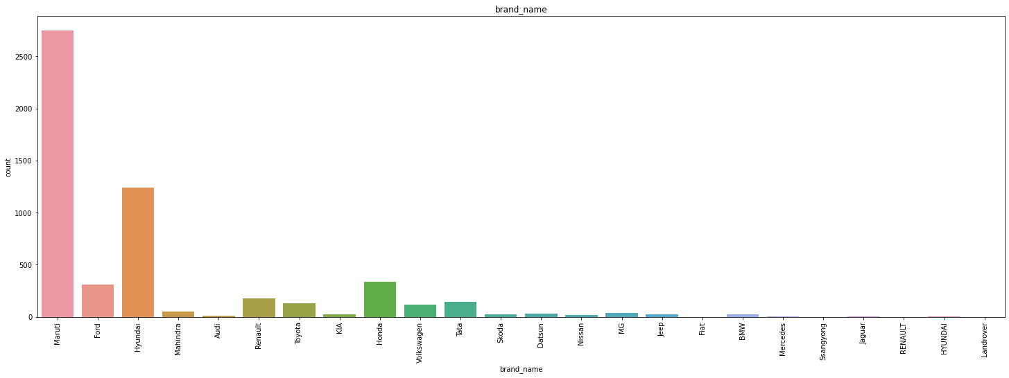
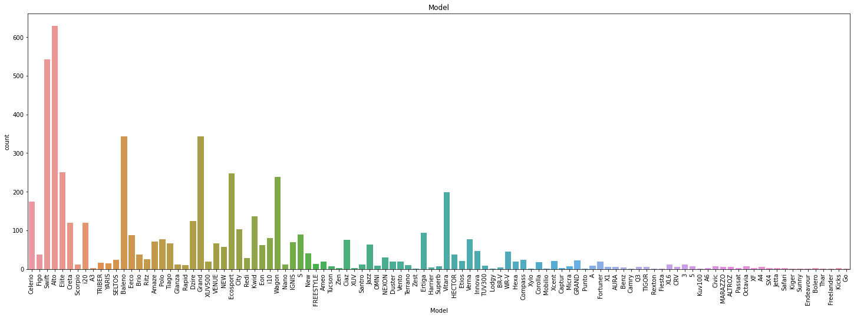
Univariate Analysis of categorical variables

Slide 9
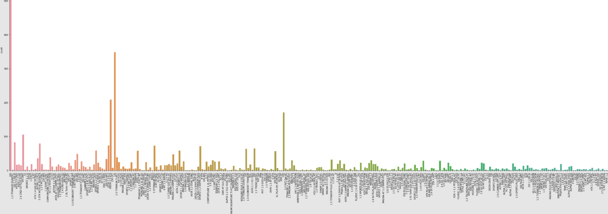
Univariate Analysis of categorical variables for Variant: Observation: We can infer that VXI and LXI model are maximum in number for sale.

Slide 10
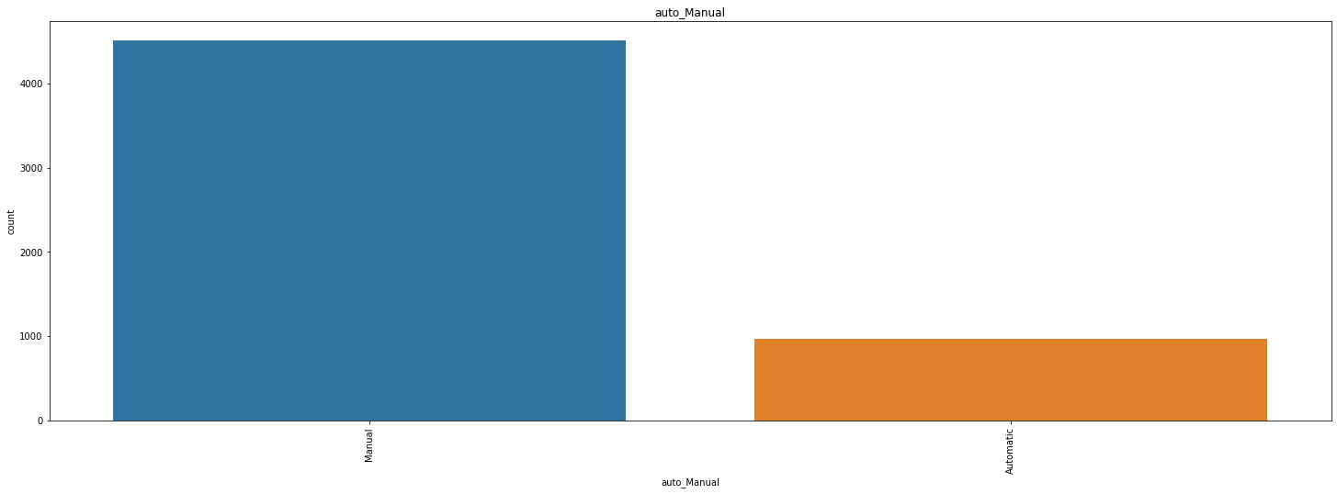
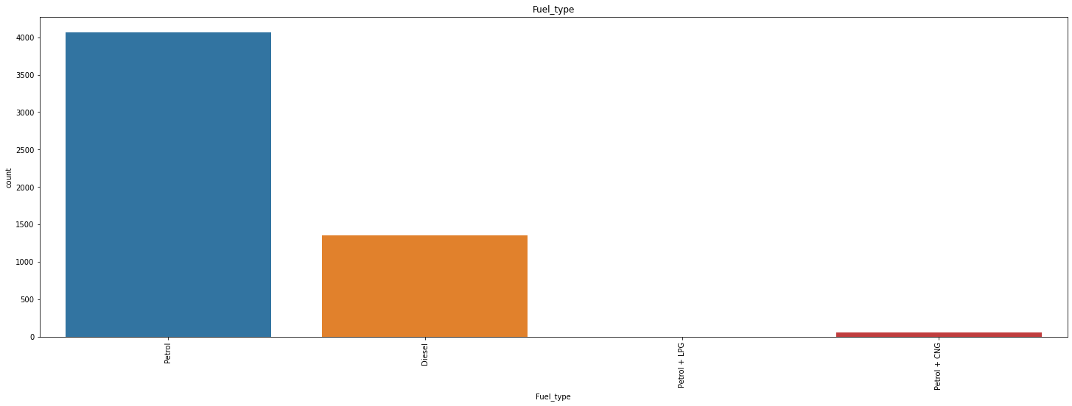
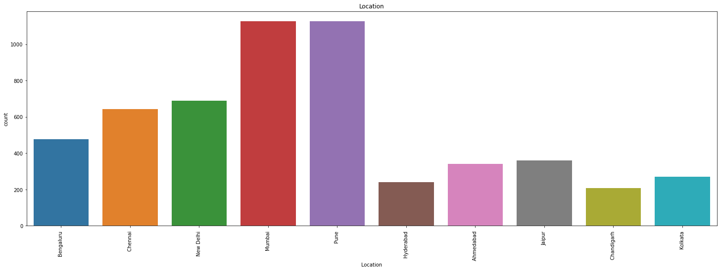
Univariate Analysis of categorical variables
OBSERVATION:
1. Largest sale is Alto car, followed by swift then elite and so on as per the visualization.
2. Highest sale is of Maruti Brand followed by Hyundai and Honda.
3. Mostly manual cars are on sale.
4. No of petrol are maximum on sale.
5. People staying art Mumbai and Pune are selling their cars mostly followed by New Delhi location.
6. We can infer that VXI and LXI model are maximum in number for sale.

Slide 11
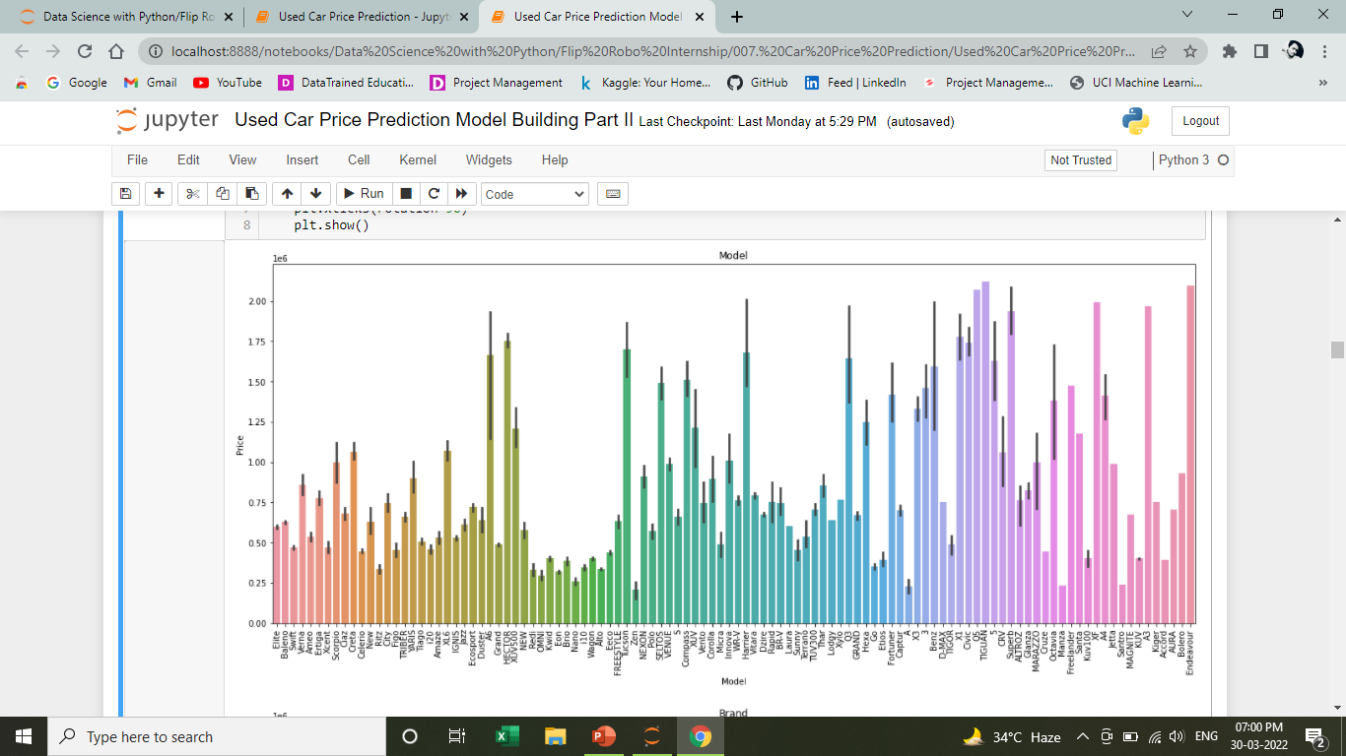
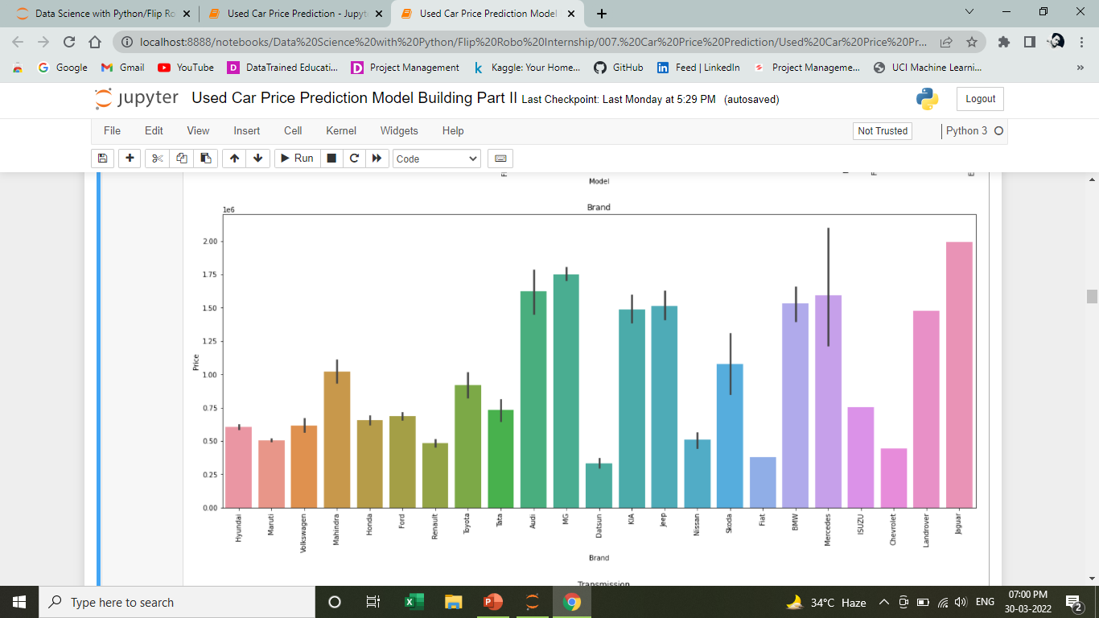
Bi-variate plotting of categorical variables

Slide 12
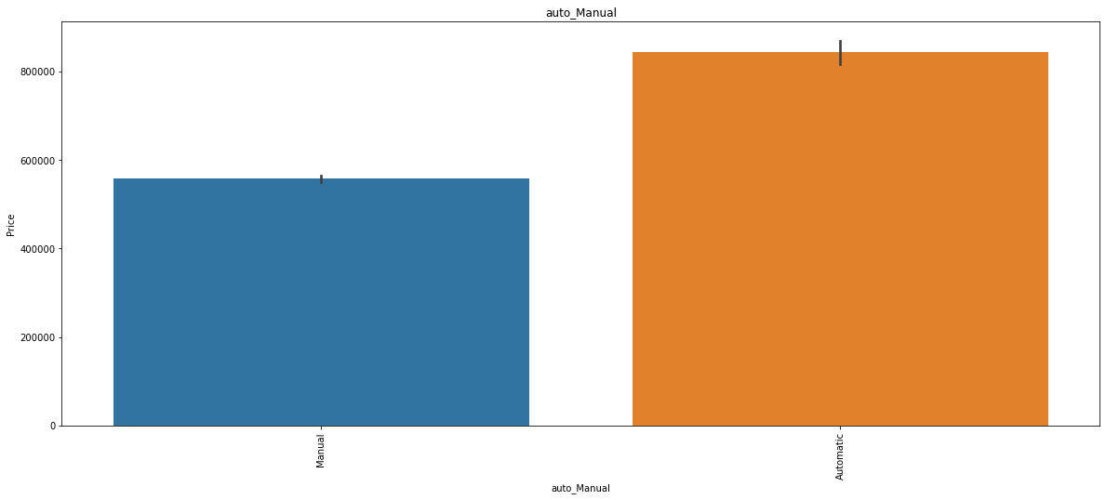
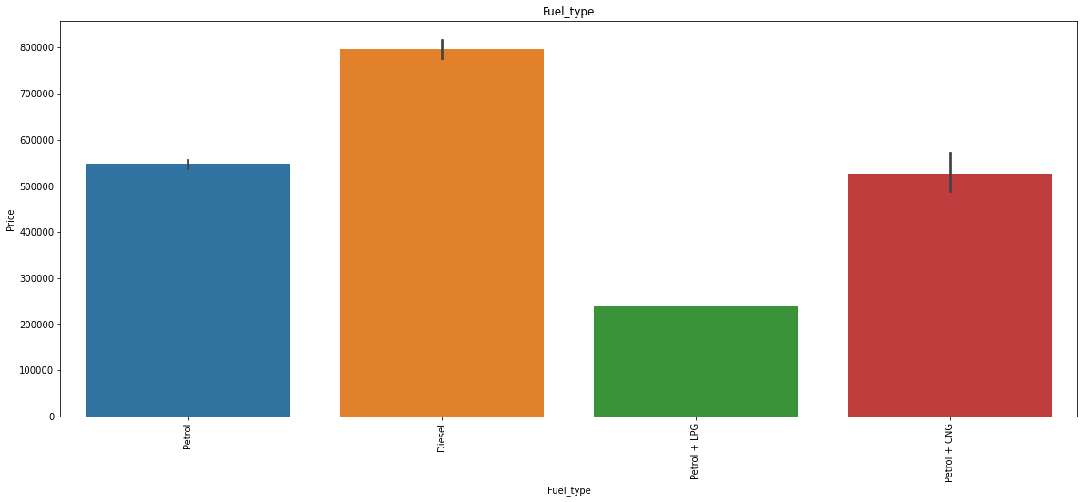
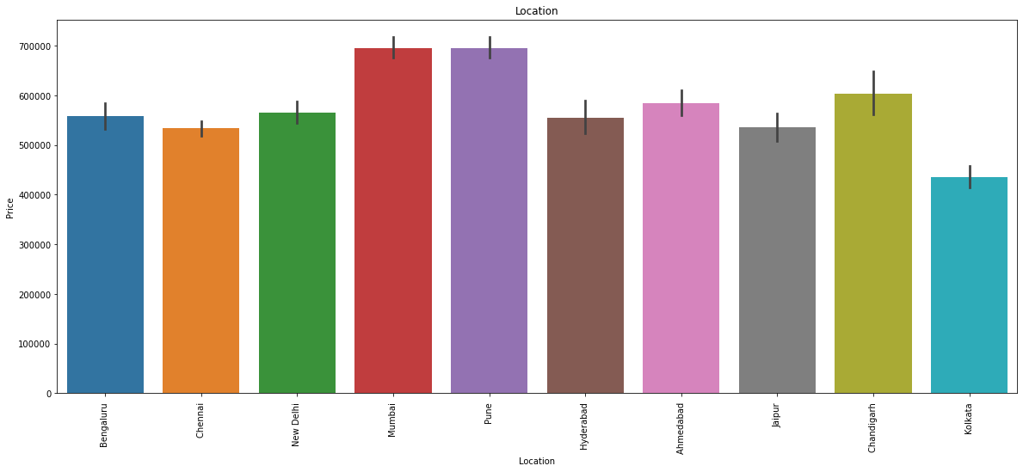
Bi-variate plotting of categorical variables
OBSERVATION:
Benz having highest price followed by Superb, Harrier and so on.
Mercedes brand is having highest price followed by Jaguar.
Automatic cars are higher in price as compared to manual cars.
Diesel cars are having higher resale value compared to petrol and combination of petrol and CNG.
Price of cars at Pune and Mumbai are highest follwed by Chandigarh.

Slide 13
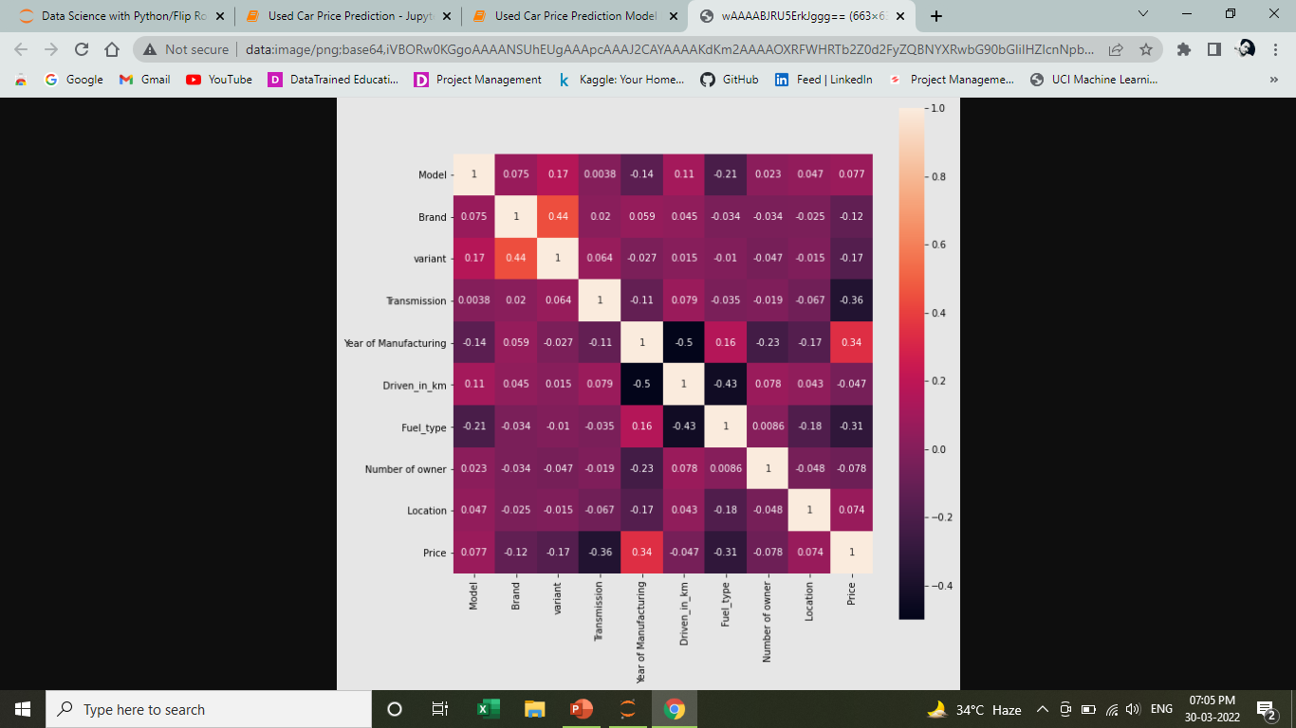
Observation: Brand Name, Variant, Manufacturing year and Price are showing mild correlation.

Slide 14
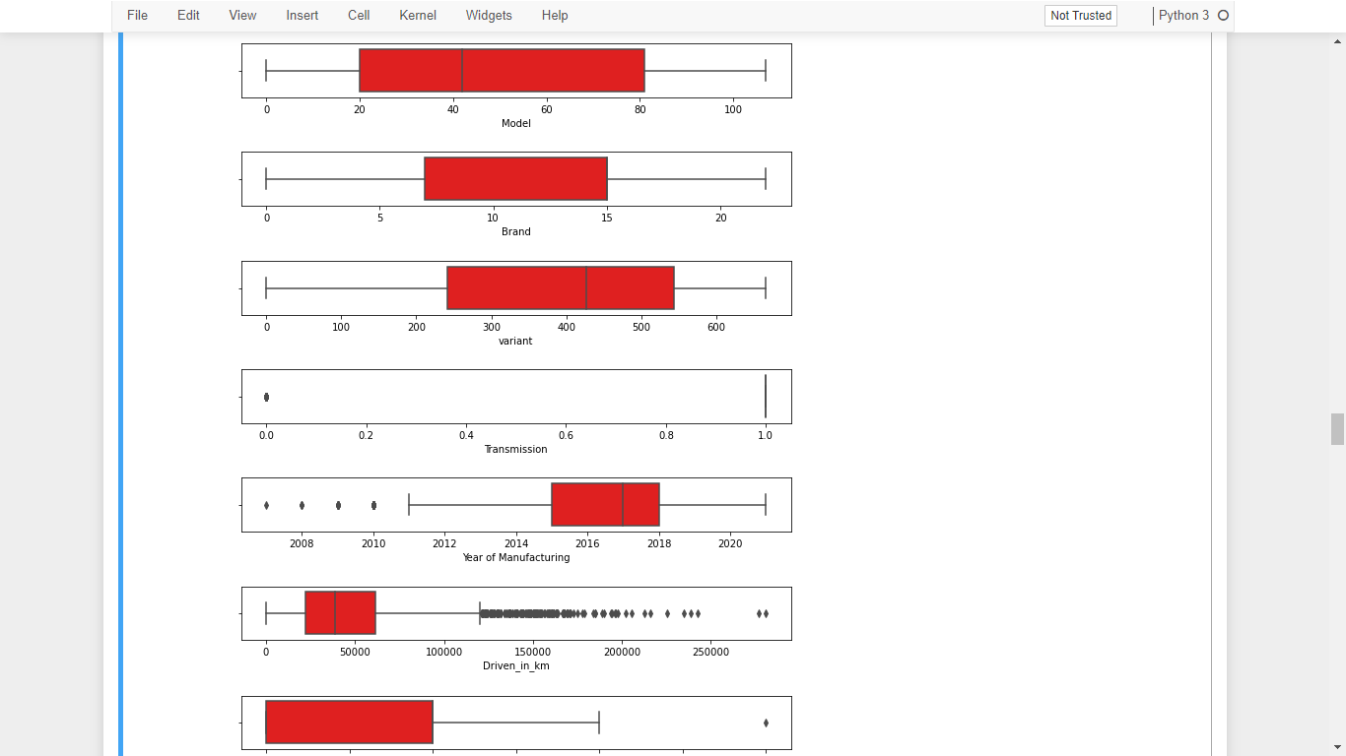
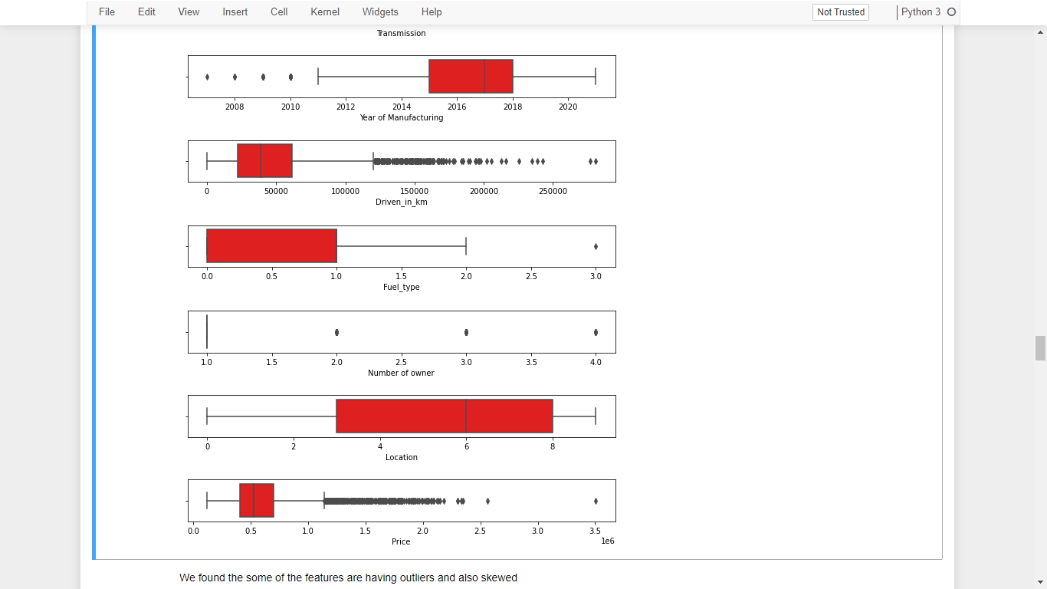
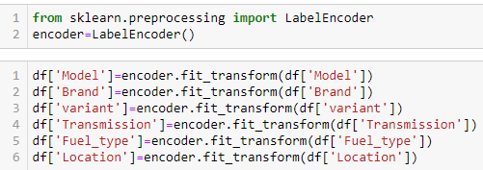
Feature Engineering
Things are done here
Label Encoding
Outlier Detecting
Checking for Skewness
Split into features and label
Treating outlier and skewness by scaling

Slide 15
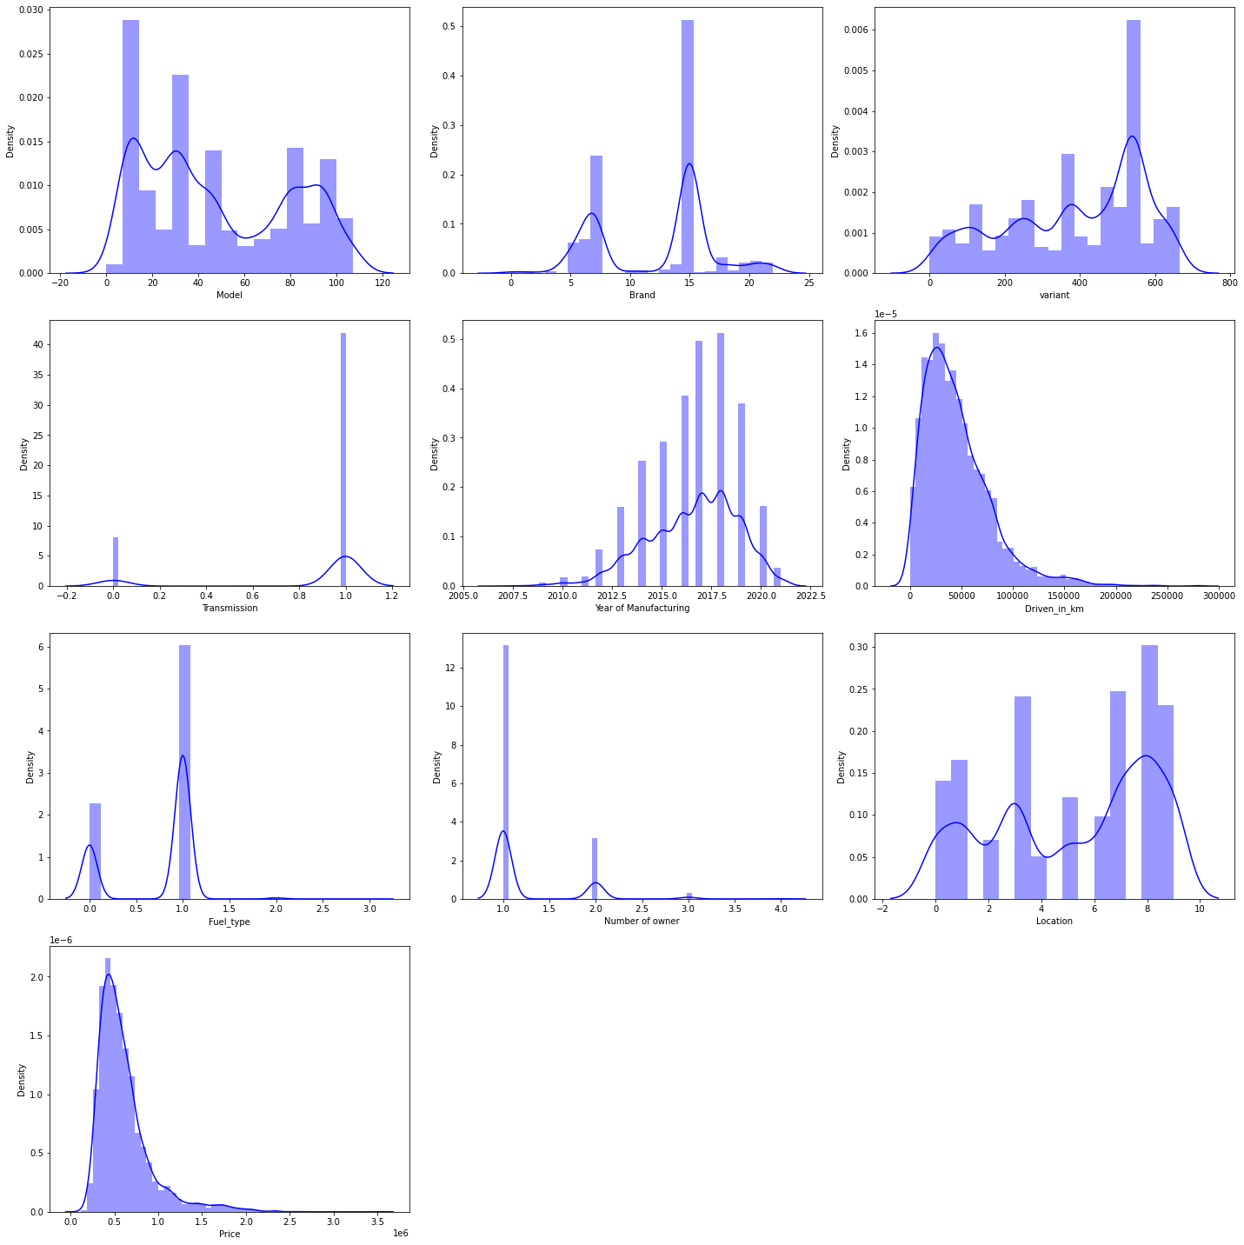

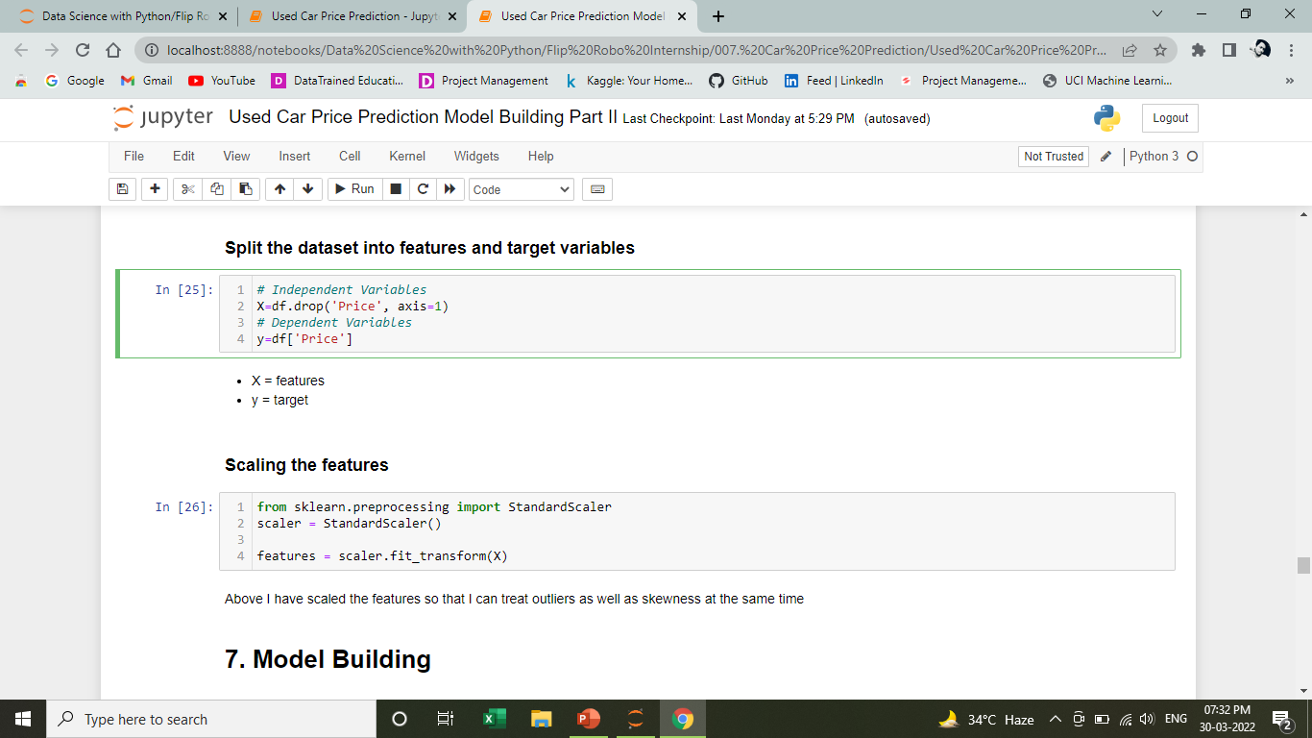

Slide 16



Models used:
Decision Tree Regressor
K Neighbors Regressor
Random Forest Regressor
Gradient Boosting Regressor

Slide 17
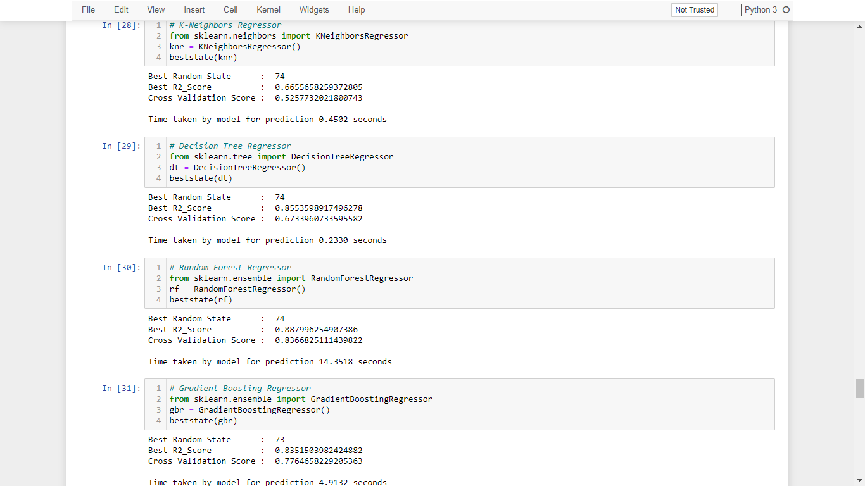
Model Building
From the dataset we can infer that it is clearly a regression problem.
On applying different algorithms, we can clearly find that both decision tree and random forest classifiers are providing good score. Now, let’s tune the parameters of this two algorithms to find the best model.

Slide 18
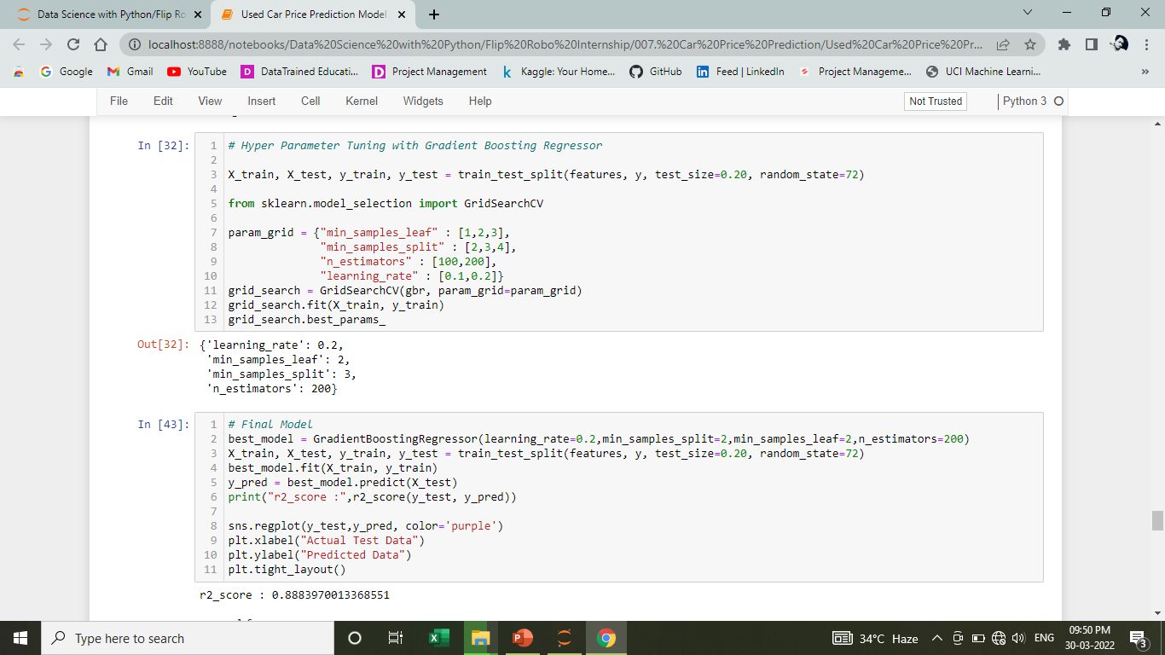
Hyper Tuning the Model
1. Hyper parameter tuning of the Gradient Boosting Regressor using GridSearchCV

Slide 19
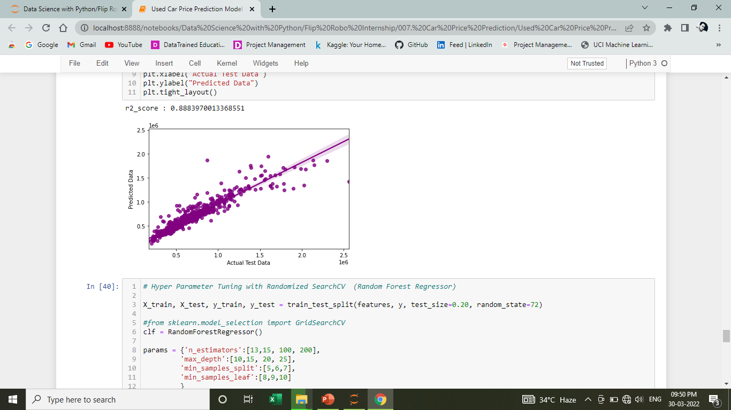
Regplot to visualize Actual Test Data vs Predicted Data and also find the best fit line of Gradient Boosting Regressor.

Slide 20
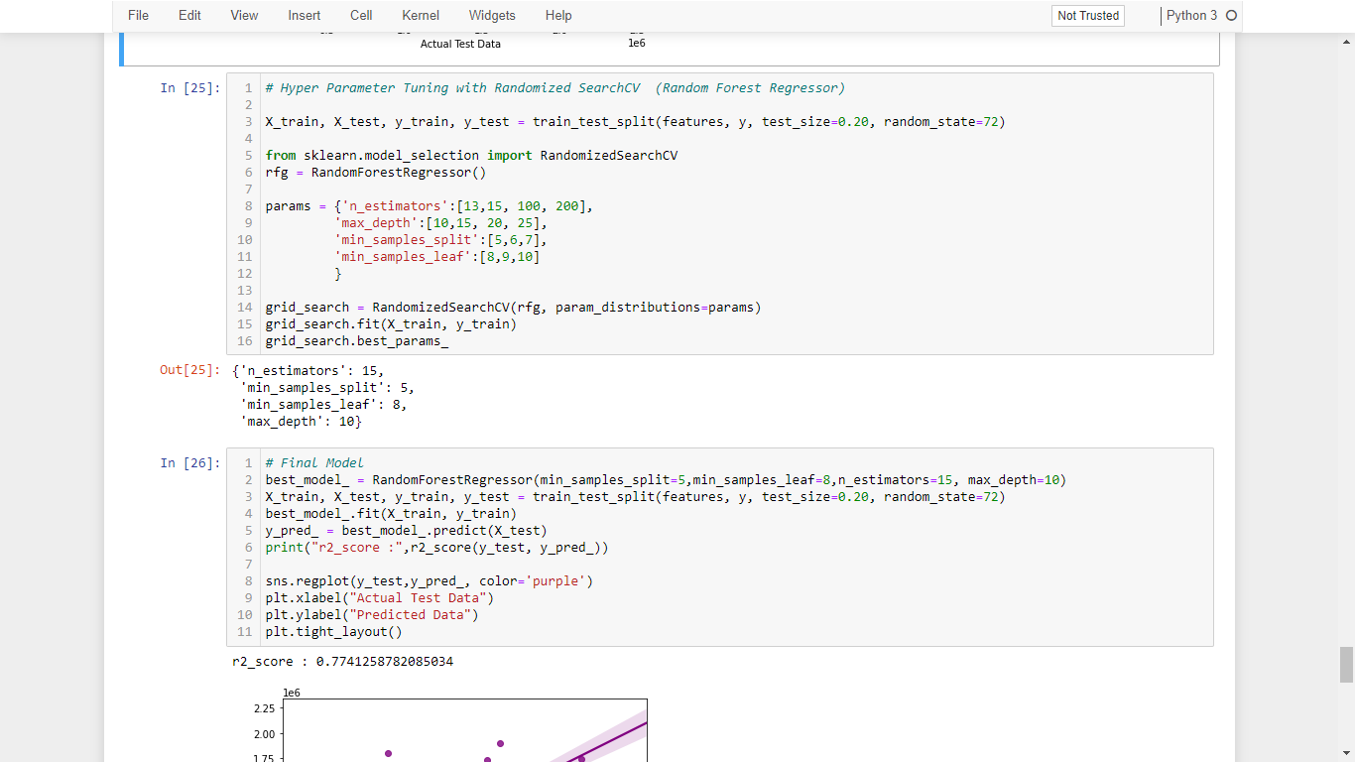
2. Hyper parameter tuning of the Gradient Boosting Regressor using GridSearchCV

Slide 21
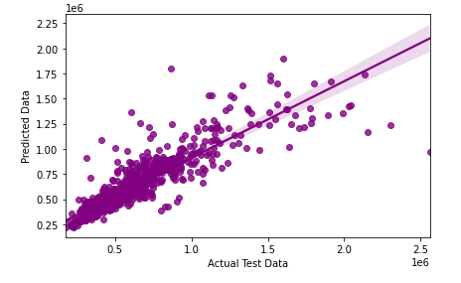
Regplot to visualize Actual Test Data vs Predicted Data and also find the best fit line of Random Forest Regressor
Hence, after comparing both the model, we found that Gradient Boost model is the best model as it gives higher r2 score and the cost function is also less in this case.

Slide 22
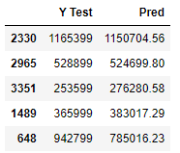
CONCLUSION
FINAL OBSERVATION:
I found that GradientBoostingRegressor is giving the best r2_score of 0.8883970013368551 (88.9%) after tuning.
Hence we can carry on with the model for prediction.
Sample of prediction:

Slide 23


